Slide 1
Cloud First Application Development
Ivy+ Human Resources Information Systems
October 27, 2017
Bryan Hopkins

Slide 2


Who is this guy?
?
Bryan Hopkins – University of Pennsylvania
App Dev Lead for Penn’s Cloud First team
Past Lives:
Cold Fusion developer (ewww)
Java developer
Architect on our frameworks team
Infrastructure team lead for our initial Banner implementation
Technology Coordination lead for campus initiatives
Keep it simple, with the support team in mind
“The State Department within the SWAT Team”
Notes:
So who is this guy standing in front of you to give DevOps relationship advice?
Hi, I’m Bryan Hopkins from the University of Pennsylvania. I’m the team lead for the application delivery side of our cloud team.
My first IT job was as a Coldfusion 4 developer at an e-commerce chop shop, and from there have worn hats as a Java developer, frameworks architect, and infrastructure team lead. So while Dev and Ops are very much separate at Penn traditionally, I’ve been on both sides.

Slide 3
Core Cloud First Team
Not everyone is speaking, but this is everyone’s work
Tim Bouffard, Application Architect
Sam Donnelly, Sr. Application Developer
Justin Ettore, Systems Architect
Dane Fetterman, IT Architect
Tiffany Hanulec, IT Technical Director
Janet Lind, IT Director
Anome Mammes, Sr. Application Developer
Lisa McBriar, Sr. Business Systems Analyst
Matt Schleindl, Application Architect
Namitha Venkatesh, Senior IT Manager
Mathias Wegner, Network Engineer

Slide 4
Today
What is an application?
Where did Penn ISC start, and why change?
What is Cloud First?
How are we working?
What have we learned?

Slide 5


What goes into an app
A user interface What people see

Slide 6

But there’s a lot more lurking…
…Technical Debt

Slide 7
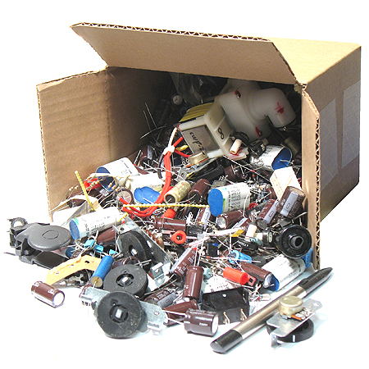

What goes into an app
Business logic Actual value

Slide 8
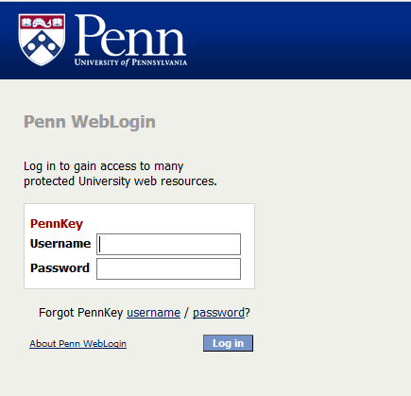
What goes into an app
AuthN and AuthZ Security

Slide 9
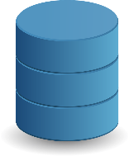
What goes into an app
Persistence and data stores Making it all matter

Slide 10

What goes into an app
Integration points Playing well with others

Slide 11

What goes into an app
Testing Proof it’s doing what it should be

Slide 12

What goes into an app
A source repository Storage for code and config

Slide 13
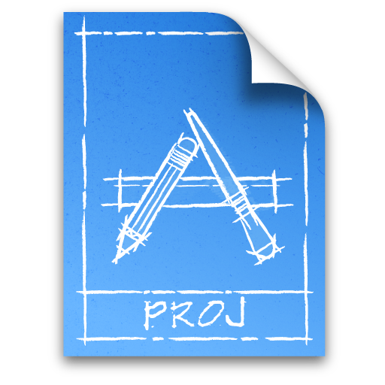
What goes into an app
Deployment pipeline Getting it built and available

Slide 14
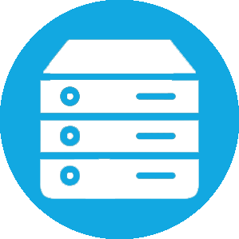
What goes into an app
A platform Somewhere to run and scale

Slide 15
That’s a lot of stuff
User interface
Business logic
Authentication and security
Persistence and data stores
Integration points
Testing
Source repository
Deployment pipeline
Platform and Infrastructure
Process and SDLC

Slide 16

By the numbers
1000+ Applications
90+ Customer organizations
300+ skills and tools
Less than 40 developers and architects
Only 3 framework contributors
5 Database Administrators
9 Systems Administrators
To support and run it all!

Slide 17

You can be on the hook for many of these, even if it’s a vendor product!
Particularly if you’re hosting the application
Security
Testing
Platform and Infrastructure
Repository
Deployment

Slide 18
And…

Slide 19
We are being judged…
Increasingly for our…
Speed!
Accessibility (usability for those with disabilities)
Responsiveness (usability on a wide range of devices)
Cost transparency
Less for our…
Risk profile
Meticulous custom services
Less is not none!
Notes:
Because there is still risk…

Slide 20
So what is Cloud First?

Slide 21

It’s a gift: Green field

Slide 22
In short:
Make it easier to choose Software as a Service options
Make it easier for partners to work with us
Re-envision the full technology stack for cloud-native agility
Model and socialize iterative and transparent value delivery
Automate or eliminate maintenance work
Socialize and share what we learn

Slide 23
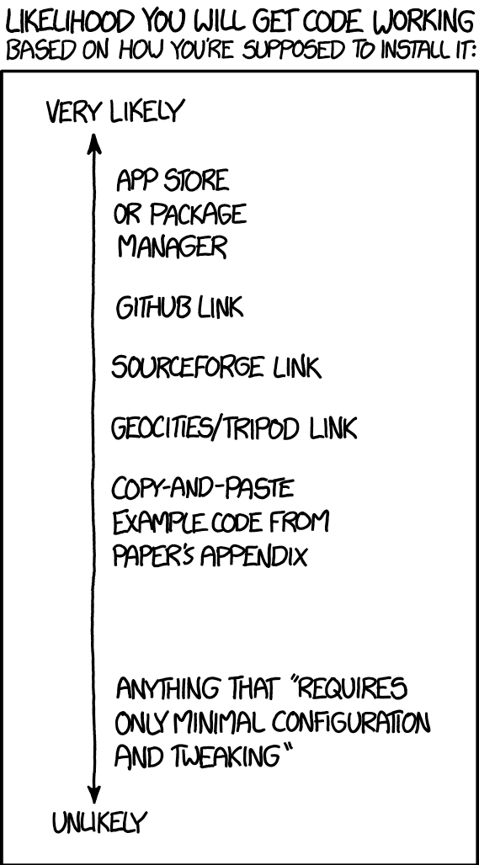
Principles
Choose simplicity, speed, and iterative improvement over up-front completeness and strict controls.
Continuously iterate and re-evaluate decisions; nothing is beyond question.
Be mindful of increasing technical debt.
Choose automated solutions over manual ones, but respect the implications to manual process owners.
Use tools and technologies “off the shelf” in secure ways and as the provider intended.
Credit XKCD.com https://xkcd.com/1742/

Slide 24

So how does that translate?
Assembling a stack
Prioritize
Evaluate
Integrate
Automate
User interface
Business logic
Authentication and security
Persistence and data stores
Integration points
Testing
Source repository
Deployment pipeline
Platform and Infrastructure
Process and SDLC
Notes:
Think of this laundry list as a technology stack
Each item is a framework to select and integrate, not something to build or customize.

Slide 25
ISC’s Cloud First Program at a glance
Core Team
Application Design & Tools
Architecture, Infrastructure, & Migration
Integration
Communications & Engagement
Org Transformation
Contracts & Procurement
Security
IAM
Funding & Finance
Client Engagement
James Choate
Owner
Tiffany Hanulec
Architecture, Infrastructure & Migration
Bryan Hopkins
Application Design and Tools Teresa Leo
Communications and Engagement
Janet Lind Integration

Slide 26
For the AppDev Team…
Someone else built it
Less control
More short-term risk
Learn to learn technologies quickly
Common terminology
More time spent on what people see, not frameworks and platforms!
Assembling a cloud native application delivery stack
Pioneering service-oriented, agile processes with automation
Pioneering mobile-first and accessible designs
We built these ourselves
Full control
Minimal short term risk
Learn one language
Unique ISC terminology

Slide 27
For the Platforms Team…
Compute resources are
Disposable and read-only
Idempotently deployed
Managed as code
According to policy
In the public cloud
Scaled to meet demand
Migrate existing virtual workloads to cloud IaaS providers
Enable fast and secure connectivity with cloud providers
Enable cloud-native application delivery stack
Compute resources are
Carefully maintained
Built individually from images
Managed by hand
According to policy
In Penn’s datacenter
Scaled to meet peak usage

Slide 28
For the Integrations Team…
Integrations
Transform and migrate data
Coherently structured
Managed by a single tool
Configured by data analysts
Supports a wide range of data sources
Prefer RESTful web services and APIs with partners
Implement cloud-based and cloud-enabled ETL solution
Establish data governance and integration preferred practices for the cloud
Integrations
Transform and migrate data
Point-to-point as needed
In many tools and languages
Coded by developers
Focused on Oracle databases
Prefer flat files and direct database links

Slide 29
Bottom Line For All Teams…
Make us nimble integrators, and maintain low technical debt.

Slide 30
Our Process
Blank Slate
Select a few areas of focus
Choose disposable placeholders
Evaluate / Pilot
Release to Production
Retrospective
Update architecture and processes

Slide 31
This is a continuous process… but where are we now?

Slide 32
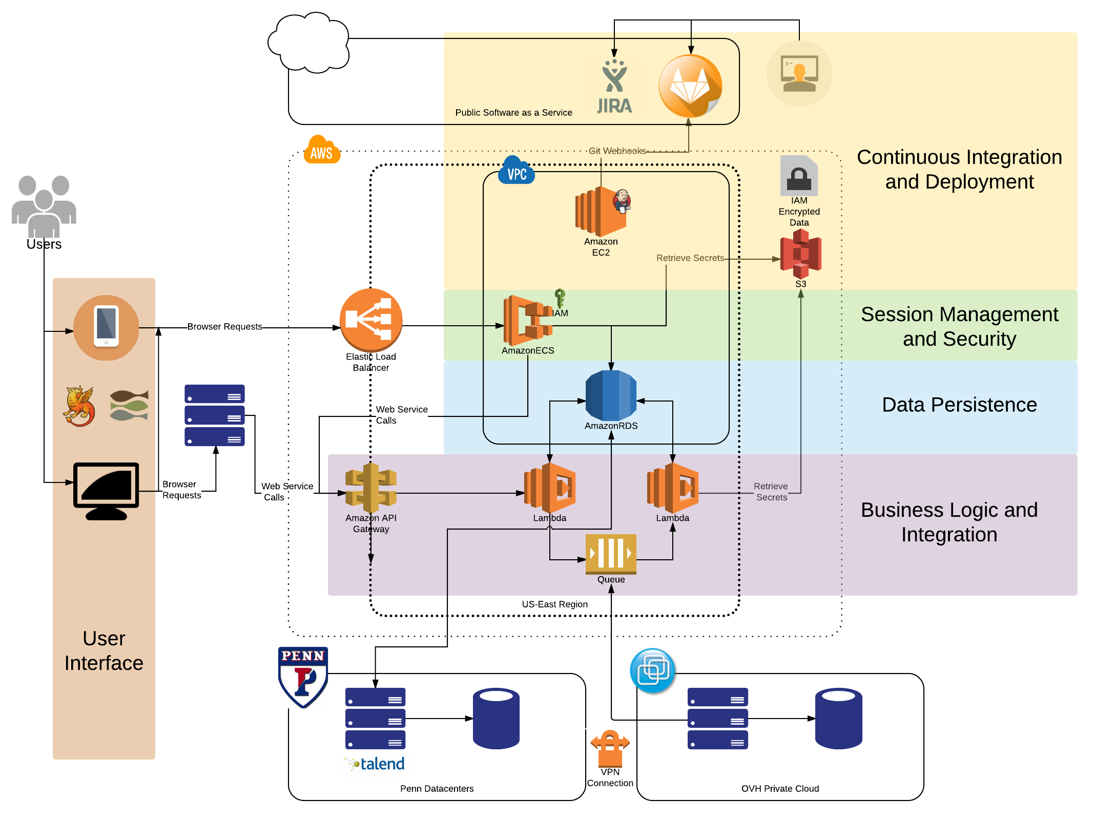
https://www.isc.upenn.edu/cloud-development-architecture-roadmap

Slide 33
Architectural Roadmapping:
More important than ever

Slide 34

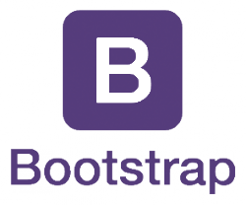

User Interface
 | For Developers… | For Analysts… | For Project Managers…
 | Full framework Thousands of components Readily available examples Data binding | Responsive by default Accessible components Cleaner, simple UIs UX vision more achievable | Open source From Google and Twitter Easy to find resources
 | In-browser debugging Angular-aware code completion Variable completion with typing with JSDoc |  | Inexpensive Contractors already know it
JetBrains Webstorm

Slide 35



Business Logic
 | For Developers… | For Analysts… | For Project Managers…
 | Full framework Thousands of packages Readily available examples Simple and powerful: few lines of code | Self documenting APIs Automatically generated test interfaces | Open source Tremendous campus presence Very easy to learn Easy to find resources
 | Django-aware code completion Great Django Testing integration |  | Inexpensive with a free tier
JetBrains PyCharm
Notes:
Pip!
By using Django you’re being a good university citizen, and can offer and receive help from a vibrant community

Slide 36
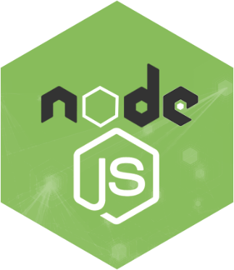
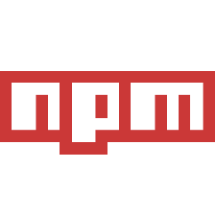
Authentication and Security
 | For Developers… | For Analysts… | For Project Managers…
 | Thousands of packages Readily available examples Incredible I/O performance Full stack | No effort PennKey login with Shibboleth | Open source Easy to find resources
 | Framework-aware code complete Fullstack debugging with AngularJS |  | Inexpensive with a free tier
JetBrains Webstorm
Notes:
Angular Fullstck – remind of demo from December
Automated patching of packages, with tests

Slide 37
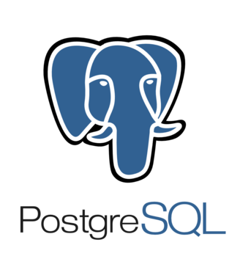

Data Store
 | For Developers… | For Analysts… | For Project Managers…
 | Oracle-like features That actually work! Highly performant Relational AND NoSQL | Drop-in replacement for Oracle Works great with Talend DB of choice for warehousing | Open source, ethical, and Free Strong local presence
 | Works with every RDBMS Powerful autocompletion | Very easy to use Don’t need to know SQL | Inexpensive
JetBrains DataGrip
Notes:
As with Django, you will have a good deal of local community support with Postgres.

Slide 38


Integration
 | For Developers… | For Analysts… | For Project Managers…
 | Fully supported SDK in every language Easy to follow examples Framework and platform agnostic Built in DDoS protection | Powerful and flexible security models API Keys and Usage plans Configurable “stages” | Incredibly cheap Fully managed Serverless Taggable for cost transparency Service orientation
 | Fully supported SDK in every language Failure tolerant Limitless scalability | Works with Mule | Inexpensive Taggable for cost transparency
Amazon SQS
Notes:
Flexible security models set us up for success no matter the future of IAM at Penn.
Also lets us easily grow in to the mobile app space.
SQS is the oldest AWS service. Highly reliable and well understood.

Slide 39
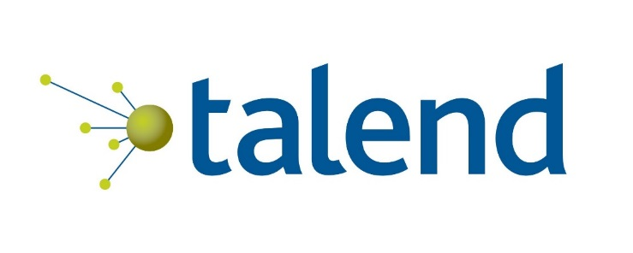
Integration
 | For Developers… | For Analysts… | For Project Managers…
 | Integrates directly with AWS Services like S3 and RDS Fully automated | No code to write or support Near real-time replication (5 minutes) | Managed Software as a Service Great support and community
Notes:
Flexible security models set us up for success no matter the future of IAM at Penn.
Also lets us easily grow in to the mobile app space.
SQS is the oldest AWS service. Highly reliable and well understood.

Slide 40

Closer Look: Microservices and SOA
Looser Coupling, More Flexible/Portable, More Complex Outer Architecture
No longer self-contained
Think service areas
DAR
Finance
Student systems
HR
Research
Composed of small pieces
Reusable
Built that way
Deployed that way
Monolithic App
Coarse-Grained Services
Microservices
WAR/EAR
Service Domain
Service Domain
Service Domain
Service A
Service B
Service C
Service D
Service E
App Server
App Server
Runtime
Runtime
Runtime
Runtime
Runtime
Runtime
Data Store
Data Store
Data Store
Data Store
Data Store
Data Store
Data Store
Data Store
Tighter Coupling, Less Flexible/Portable, Less Complex Outer Architecture
Notes:
A little sidebar about service orientation.
We’ve traditionally been focused on the left hand side. Trying to drift right.
Think service areas and not apps.
Architects really have a big role.

Slide 41







Closer Look: Microservices and SOA
No longer self-contained
Think service areas
DAR
Finance
Student systems
HR
Research
Composed of small pieces
Reusable
Built that way
Deployed that way
DAR Apps
Donate
Pledge
Volunteer
ATLAS
Data Warehouse Collection
DAR Services

Slide 42
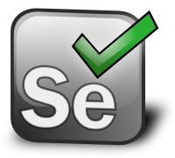



Testing
 | For Developers… | For Analysts… | For Project Managers…
 | Confidence in the spec | Easy to create and understand Fully automated regression tests | Bugs caught early take 10x less time
 | Built for AngularJS Easy stubbing and mocking with Sinon
 | Straightforward Like Junit Easy to test WebServices: no setup
KarmaJS
Notes:
3 types
End to End – Tests everything by hitting the deployed app
UI – Tests logic in the browser
Service – Tests business logic in your back end

Slide 43

Source Repository
 | For Developers… | For Analysts… | For Project Managers…
 | Offline work Easy branches and merging Webhooks for CI/CD integration | Create documentation developers actually use Intuitive web interface to browse files | Open source Universal adoption (git)
Gitlab Cloud

Slide 44
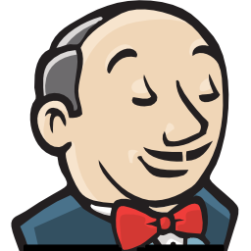
Deployment Pipeline
 | For Developers… | For Analysts… | For Project Managers…
 | Automate with Python Developers’ Swiss Army knife | More frequent deployment Automated tests run on each build Slack Integration
Jenkins
Notes:
Lets you automate all your checklists with each build.
No need for stress.
No need for excel.

Slide 45

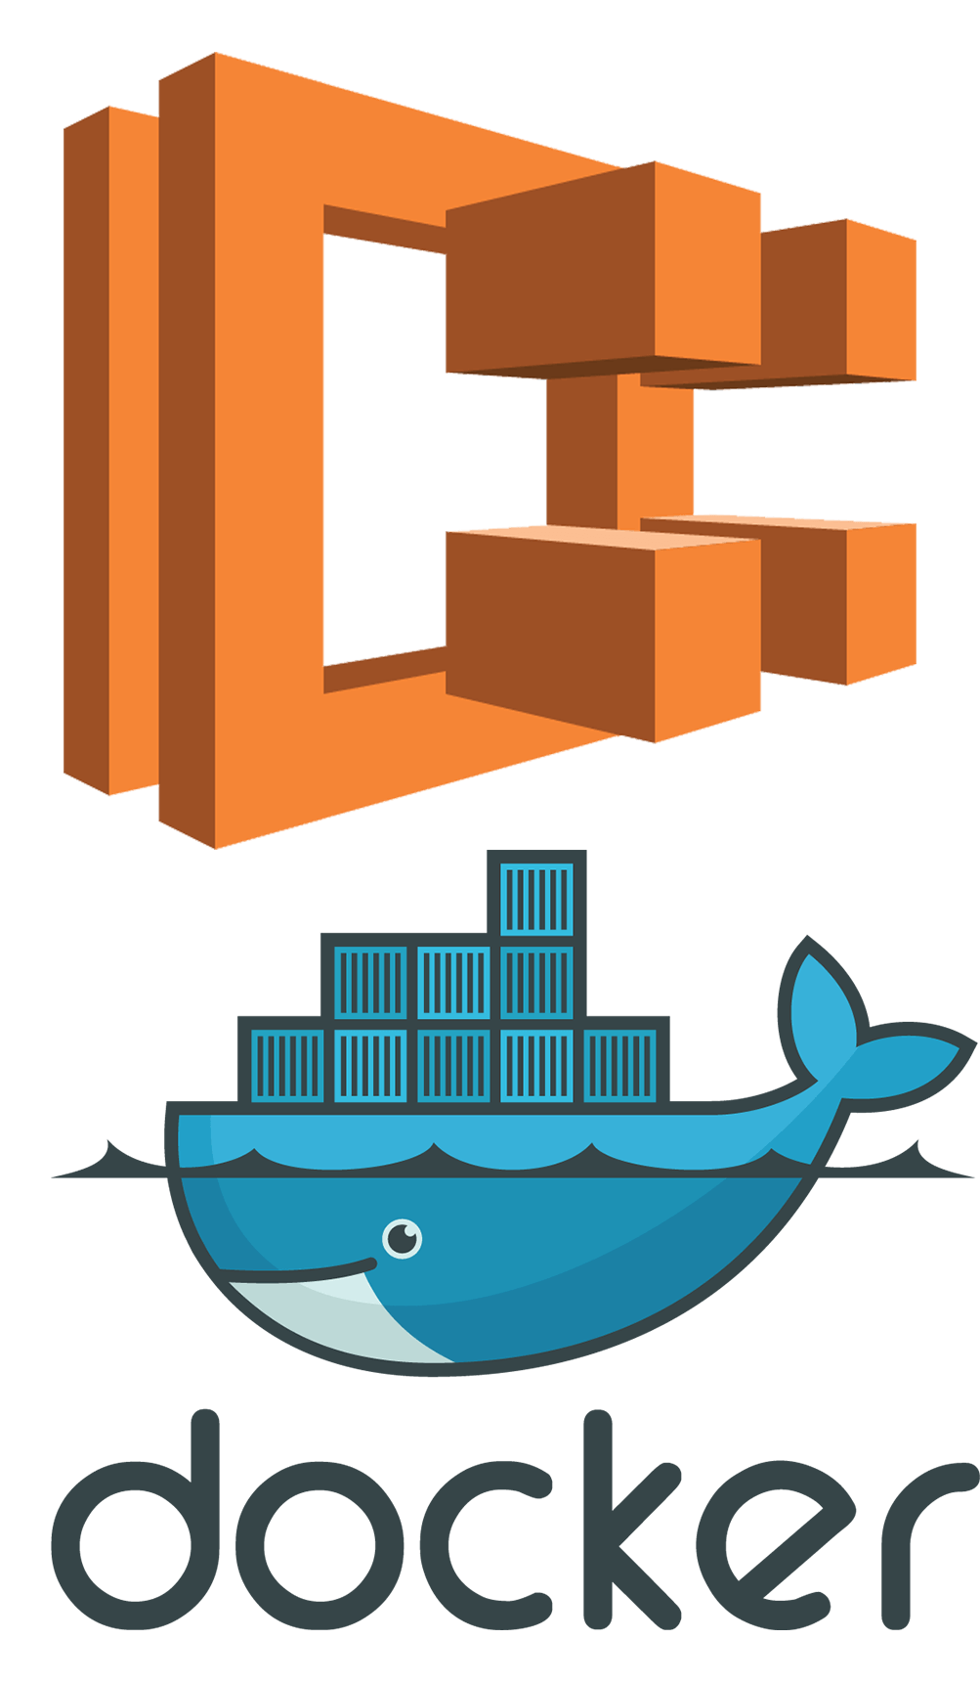
Platform
 | For Developers… | For Analysts… | For Project Managers…
 | Serverless Only worry about code Provisioned as code Isolated microservices Easy DRF integration with Zappa |  | Incredibly cheap Nothing to patch Massively scalable Taggable for cost transparency
 | Can run any docker image Service isolation Blue-green deployments |  | Can be sized and scaled to order Taggable for cost transparency
Amazon Lambda
Notes:
ECS and Docker – why not always go serverless?
Sometimes you need processes that run longer than 30-90s, like if you’re keeping websockets open with the browser.
Physical, virtual, OS, container, apache, tomcat… none of it. Just your code.

Slide 46

Platform
 | For Developers… | For Analysts… | For Project Managers…
 | Fully Managed Service Provisioned as code | Access like any other database | Fully managed Nothing to patch Scalable Taggable for cost transparency

Slide 47

Closer Look: Infrastructure as Code
Everything about the app is just code
Creating it defines and documents it
No patching. Delete and re-create.
No waiting! No manual action! Right the first time!
Notes:
So what do I mean when I keep saying “provisioned as code?”
You write scripts and JSON that create and define your whole platform and security model.
Documented and up-to-date, no ifs ands or buts.

Slide 48



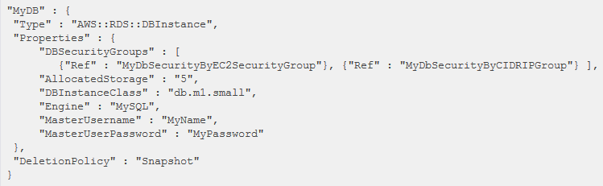
Closer Look: Infrastructure as Code

Slide 49
If everything is code, process from that world matters more

Slide 50
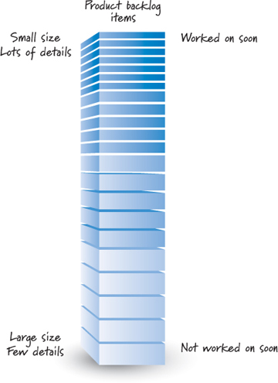
Closer Look: Cloud First Agile
Terminology
Backlog Sorted list of everything the clients want. Things at the top are better defined than things at the bottom.
Sprint Period of time where the team focuses on implementing the clients’ top priorities.
User story The basic unit of work capturing a feature or requirement from the end user’s perspective.
Epic A collection of User Stories that together define a significant feature or business process

Slide 51

Closer Look: Cloud First Agile
Prioritize and Define
Pick top 1-2 stories
Feature files
Build and Iterate
Technical subtasks
Test and Deploy
E2E Tests
Able to launch?
Create backlog
Create VERY high level story list
Screens
MVP?
Unit tests
Playbook
Daily Standup
Notes:
Emphasize importance of architects –
Take the stories and break them up into small units of technical work
Figure out how all the pieces fit together and how to manage the technical side of change

Slide 52

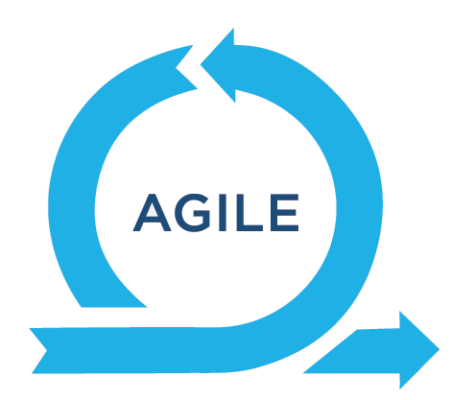
Process and SDLC
 | For Developers… | For Analysts… | For Project Managers…
 | Familiar tool Easy to use Highly collaborative | Plugin store Dependency tracking Drag and drop prioritization | Transparency Reports and progress-at-a-glance Collaborate externally
 | Focus on only a few details at a time Frequent feedback and adjustment | Focus is on “Yes” Rely on domain knowledge and organization No document writing | Speed and time-to-value Responsive to changes in priorities
Notes:
Don’t really need to sell this.
Groups like Melina’s team are already off and running showing the power of agile.

Slide 53
Nota Bene
There is more work going on than what’s discussed here!
Exploration into Microsoft Azure and Google Cloud Platform
Migrating workloads from Penn Datacenters to Cloud IaaS providers
Advanced configuration management
Many Software as a Service implementations
Microsoft Office 365
Workday
Banner / Pennant
More!

Slide 54
In Summary

Slide 55
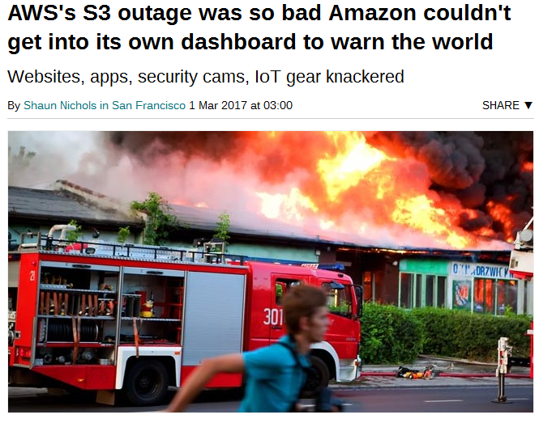
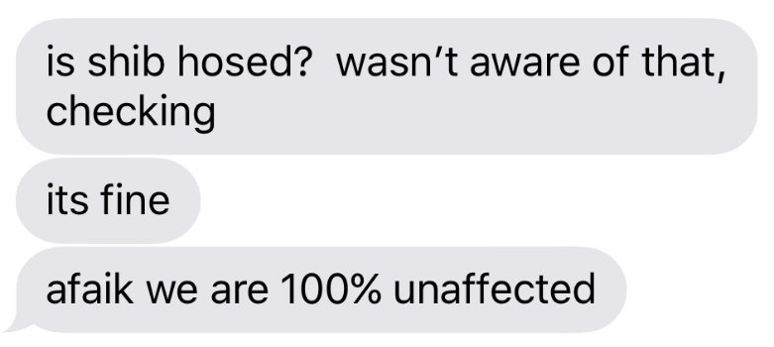
A shift in risk, not a magic bullet
AWS S3 Outage – 2/28/2017
Data Center Outages – 6/21,28/2017
Bad day for the cloud
Developers in the dark
Apps couldn’t restart
Images didn’t load
Good day for the cloud
Developers unaffected (but it was dark)
Apps ran and could be built (thanks to Shibboleth distribution)
Campus integrations degraded gracefully
Credit: Matt’s iPhone
Credit: The Register https://www.theregister.co.uk/2017/03/01/aws_s3_outage/
Notes:
Its just been shifted, not eliminated.
But we think the odds are on our side, and we can shift our focus to Penn challenges instead of technology challenges

Slide 56
What’s next? Questions…
Lowering the barrier of entry for API Services
Increasing the synergy of API Services
Improving test automation
Improving build automation
Improving resiliency
Improving agile processes
Train and empower our staff
Keeping technical debt short term: evolving
… and whatever’s on your mind. Thank you!

Slide 57
Additional Thanks and Credits
The Full Cloud First Team
James Choate
Dave Curran
Katie Faucett
Tiffany Hanulec
Peter Heinemann
Teresa Leo
John Mulhern III
Frank Nguyen
Vasu Raman
Michel van der List

